Slide 1
Elements of the Short Story
ELA 9
Mrs. M. Borys
Our Lady of Mount Carmel

Slide 2
Plot Diagram
What are the names of the numbered elements on the plot diagram?
introduction / exposition
initial incident / motivating incident
rising action
climax
falling action
resolution
4
5
3
6
1
2

Slide 3
Denouement
What is meant by the term denouement?
  Denouement is a final revelation in a story.
Does every story have a denouement?
  Not all stories will have a denouement.

Slide 4

Elements of Plot
Other names: introduction/beginning
Exposition
The part of the story that provides background information and sets the story up

Slide 5
Other name: initial incident
Motivating Incident
The event that happens that sets the story in motion

Slide 6
Rising Action
All the events of the story that take place between the motivating incident and the climax (this is the longest part of the story)

Slide 7
Climax
The part where the major problem/conflict is solved, usually the highest point of action

Slide 8
Falling Action
All the events of the story that occur after the climax, and before the resolution

Slide 9

Other name: outcome
Resolution
The tying up of all the loose ends of the story that were not settled in the falling action

Slide 10

Setting
What is the setting of the story?
Setting is where and when a story takes place
What kind of information can be provided within the setting of a story?
Information provided in the setting: general location (e.g.: Edmonton), time, year, specific locations (e.g.: St. Mark school)
Why is a good understanding of the setting important to understanding a story?
A good understanding of setting is important because it can explain why a character is faced with a certain problem or why they may handle situations in a certain way

Slide 11
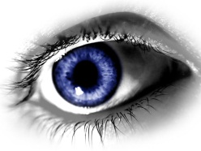
Points of View
What is meant by the term “point of view”?
Point of view is the perspective from which the story is told
There are 4 different types of point of view. They are:
Third Person
        Limited Omniscient Omniscient
        Objective/Camera View
        First Person (observer & participant)

Slide 12
Point of View | Definition | Benefits to using | Disadvantages to using
Limited Omniscient | The narrator can see into the mind and thoughts of one character but is not a character in the story | Realistic, we see world through one person | Limited field of observation, difficulty having character aware of all important events
Omniscient | The narrator can see into the minds and thoughts of all characters and is not a character in the story | Most flexible; author can control easily inform reader about everything important | Author can come between reader and story, shifting from character to character may create confusion
Objective/ Camera | The story is told as though a camera is filming the action, there are no insights in to the minds of the characters | Impartial, offers most speed of action, reader must interpret what they read with no assistance | Author cannot interpret or assist the reader, relies heavily on action and dialogue
First Person a) observer b)participant | a)someone is telling the story who is not physically in it. b)The narrator is a character in the story. The story is told through the use of personal pronouns | Eyewitness account gives immediacy, realism, author can create dramatic irony | Bias or limited knowledge of narrator

Slide 13
Character
Authors use 2 methods for describing characters, direct and indirect - complete the chart based on these methods of characterization
Method | Definition | How might this look in a story?
direct | The author tells us directly about the characters | Author makes direct statements - John is a lively young man with blue eyes and blond hair
indirect | We learn about characters without being directly told and we draw our own conclusions | How the character acts, dresses, talks, responds to things, what the other characters say about him/her, how they respond to the character Eg: Someone helped her cross the street.

Slide 14
Character Chart
Type of Character | Definition
Round | A character that we know a great deal about
Flat | A character that we know relatively little about (one or two traits)
Static | A character that does not change from the beginning of the story to the end
Dynamic | A character that undergoes a change in their personality, attitude or thinking by the end of the story
Stock | A character that is stereotyped -The “dumb blond” -The “jock”
Protagonist | The main character in the story, usually the good guy, but does not have to be
Antagonist | The person or thing that is opposing the protagonist, usually the bad guy, but not always

Slide 15
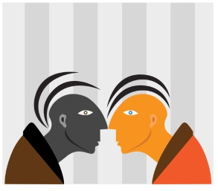

Conflict
What is meant by the term conflict?
  A struggle between 2 forces
Person vs. Man
  One person vs. another
  E.g.: Jack and his arch enemy are in a battle to the death
  (This conflict does not have to be a physical fight; it can more subtle as well – they are both trying to date the same girl)

Slide 16
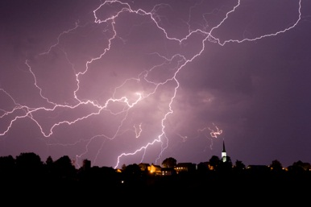
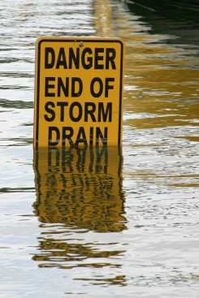
Conflicts
Person vs. Her/Himself
  A character undergoing a personal struggle
  E.g.: Sheila is obsessed with her self image and struggles to lose weight
Person vs. Nature
  A character in a struggle against a natural element
  E.g.: Bob struggles to survive the hurricane

Slide 17
Conflicts
Person vs. Supernatural
  A character in a struggle against something non –human (animals, aliens, other creatures)
  E.g.: Freda is being hunted by a sasquatch

Slide 18
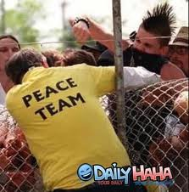
Irony
What is irony?
  Irony involves a contradiction between appearance and reality. Irony results when there is a difference in point of view between a character and the narrator or reader
Verbal Irony
  When a character/author says one thing, but suggests or intends the opposite
Situational Irony
  The difference between what is expected and what actually happens

Slide 19
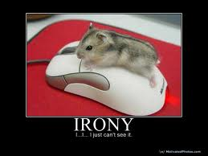
More Irony
Dramatic Irony
  The reader knows something that a character does not know
Examples of Irony
Dramatic – a brother and sister are always fighting and the brother cleans the toilet with her toothbrush, which the reader knows, but the sister doesn’t
Situational – a soldier returns home from years of war uninjured and is killed in a car accident
Verbal – saying to an over weight friend, “oh, you’re not fat, there is just more to love!”
Hyperbole – “You’re as big as a house!”
Sarcasm – “Yeah, you’re not fat at all!”
Understatement –“You could maybe stand to lose a few pounds”

Slide 20
Miscellaneous Terms
Term | Definition
Flashback | Flashing back, within the story, to something that happened before the story took place. E.g.: In a story about a homeless man, he thinks back to how he lost his job and ended up homeless
Foreshadow | Hints of what is to come later in the story E.g.: A character saying, “The weather is bad Billy, I have a feeling we shouldn’t go for the boat ride tomorrow,” and Billy dyeing at sea in the storm is foreshadowing
Theme | The meaning or purpose of a story, usually implied and not stated directly, usually makes a comment about human nature. E.g.: In “Thank you Ma’am” the theme is that if given the chance, we will see that there are people willing to help others, no matter what
Mood | The overall feeling created by the author E.g.: In “The Tell Tale Heart” the mood is tense and uncertain

Slide 21
More Miscellaneous Terms
Term | Definition
Atmosphere | Goes hand in hand with setting, the feeling created by the setting
Tone | Tone is the author’s attitude. Much like tone of voice, it can be sympathetic, sarcastic, condescending, grateful, etc. For our purpose tone, atmosphere and mood are basically interchangeable.
Symbolism | Using one thing to represent another E.g.: A white dove symbolizes peace
Complication | A problem that the main character faces along his/her journey to solving the main conflicts (can be thought of as a speed bump). E.g.: While trying to battle the Germans in the war (conflict) the British had a bout of small pox that killed many of their men

