Slide 1
Film Studies Visual Literacy

Slide 2
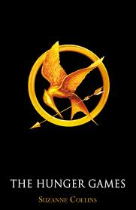
Did you know?
1/3 of all films ever made are adapted from novels. That is 33% of films inspired by novels.
If you include other literary forms including plays, poems, or short stories, the number rises to 65% of films adapted from literary forms.

Slide 3
Visual Literacy
Visual literacy involves all the processes of knowing and responding to a visual image, as well as all the thought that might go into constructing or manipulating an image.
Students must actively view films in order to analyze the meaning communicated through the images.

Slide 4
Visual Literacy
Films, like literature, use effective techniques that force viewers to focus on significant events that develop character, theme, plot, mood, conflict and symbolism.
Visual literacy is the ability to interpret, critically respond, discuss, and develop meaning from information presented in images or film.

Slide 5
Camera Distance
Long Shot:
A shot in which the background dominates.
Figures are often included to give a sense of scale and space.
Long shots can be used to establish setting.

Slide 6
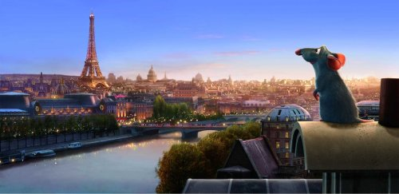
Long Shot

Slide 7
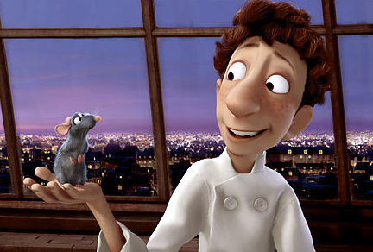
Camera Distance
Medium Shot:
A figure is framed from the waist up.

Slide 8
Camera Distance
Close-Up:
A detailed shot usually showing just the head or significant object.
Draws attention to an object or facial expression of a character.

Slide 9
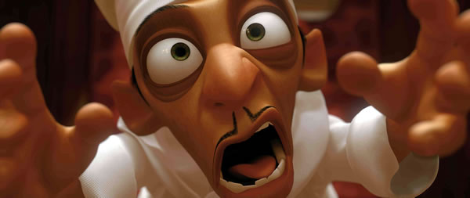
Close-Up

Slide 10
Camera Distance
Extreme Close up:
A shot that singles out a specific portion of the body or isolates a detail.
Reinforces the significance of an object.

Slide 11
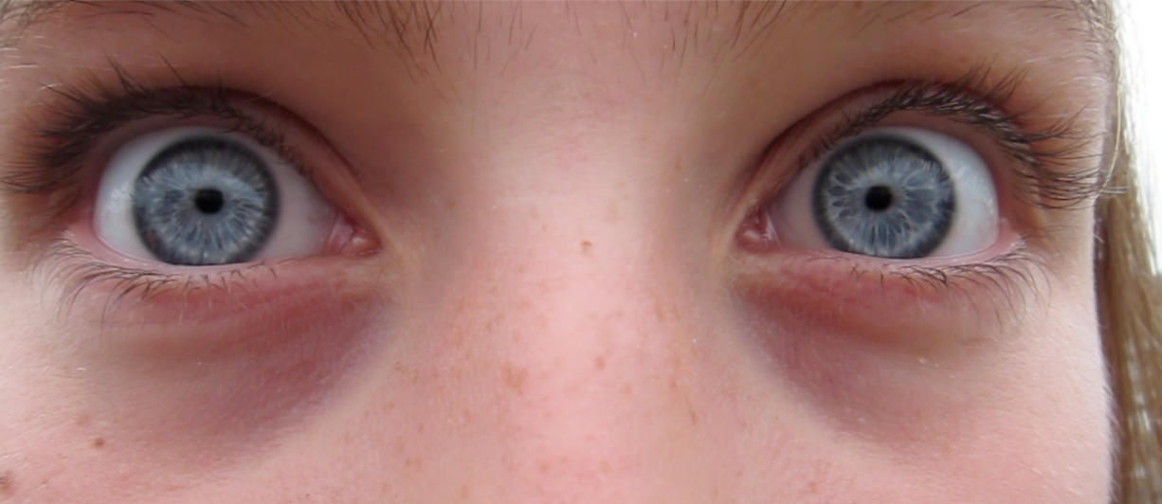
Extreme Close-Up

Slide 12
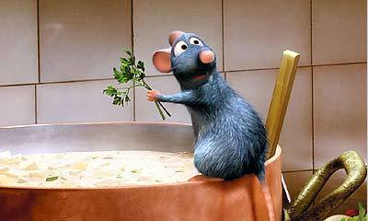
Camera Positioning
Flat Angle:
The camera is eye level and on the same plane as the subject.

Slide 13
Camera Positioning
Low Angle:
A shot in which the camera literally and figuratively looks up at the subject.
This angle is often used to give the subject a dominating or powerful presence.
The audience is made to feel submissive or small.

Slide 14
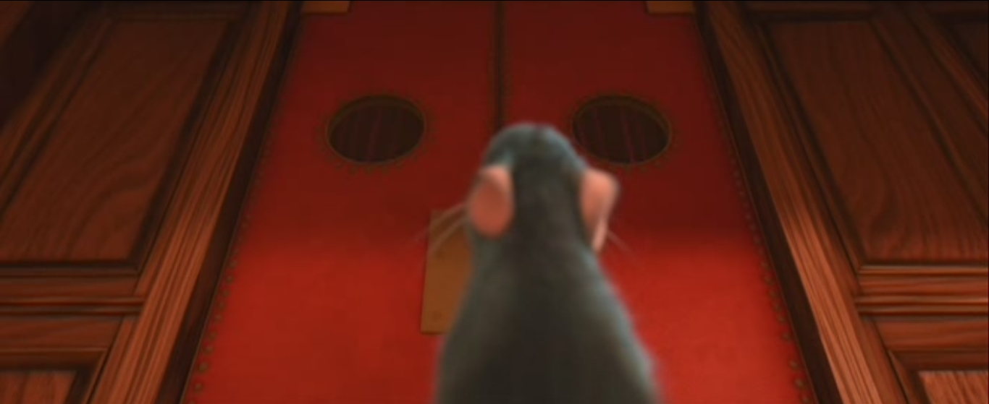
Low Angle

Slide 15
Camera Positioning
High Angle:
A shot in which the camera literally and figuratively looks down on the subject.
It can be used to make the subject seem small or insignificant.

Slide 16
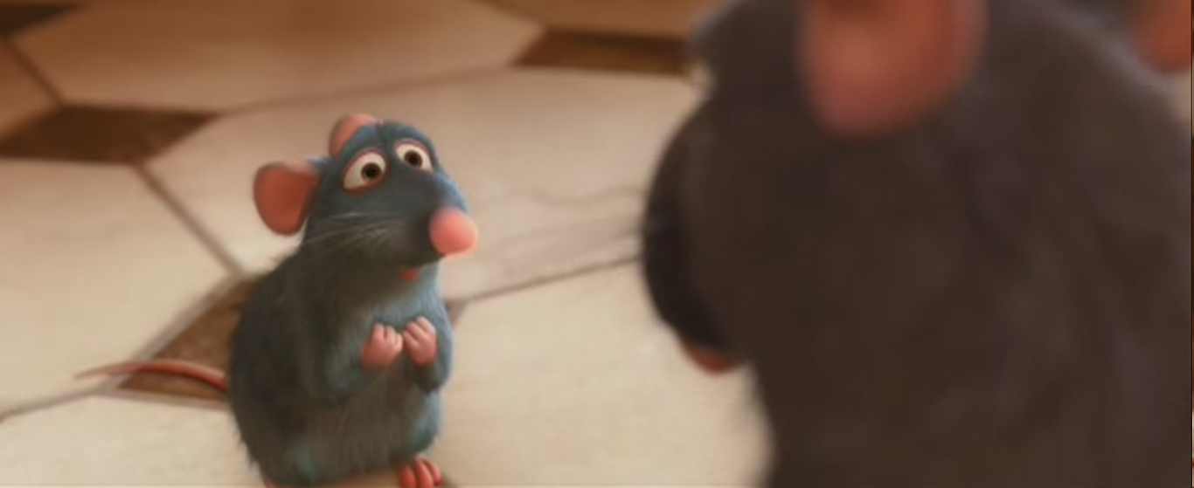
High Angle

Slide 17
Camera Positioning
Crane/Aerial Shot:
A type of high angle shot that can be either stationary or moving.
It is positioned higher up and often at a steeper angle than a basic high angle shot.
Acts like a bird’s eye view.

Slide 18
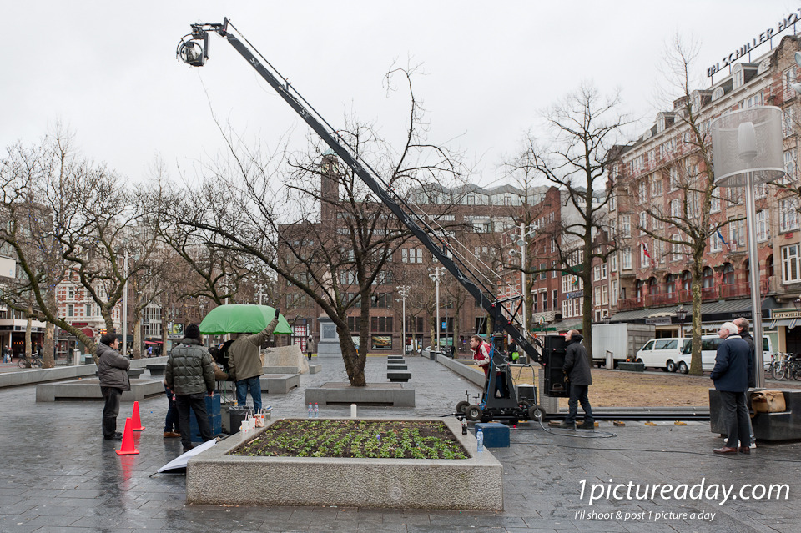
Crane

Slide 19
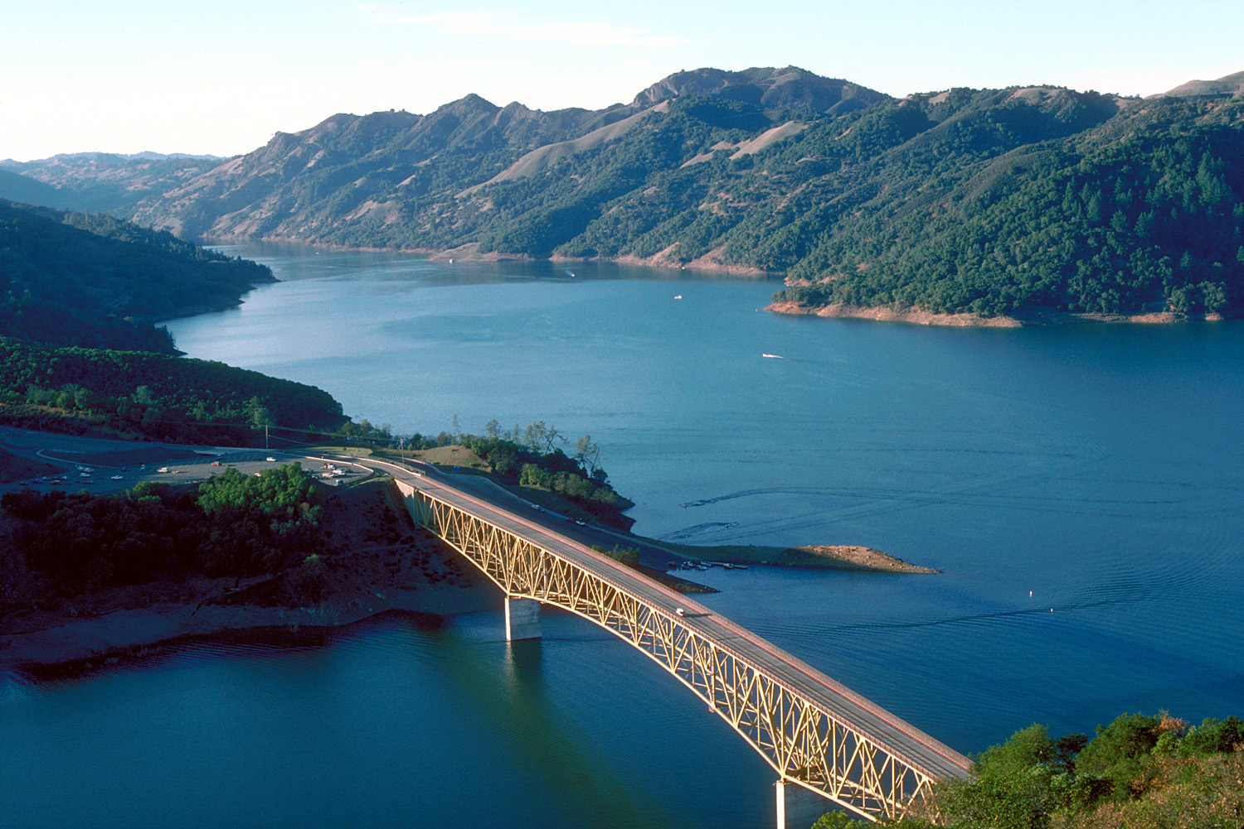
Aerial Shot

Slide 20
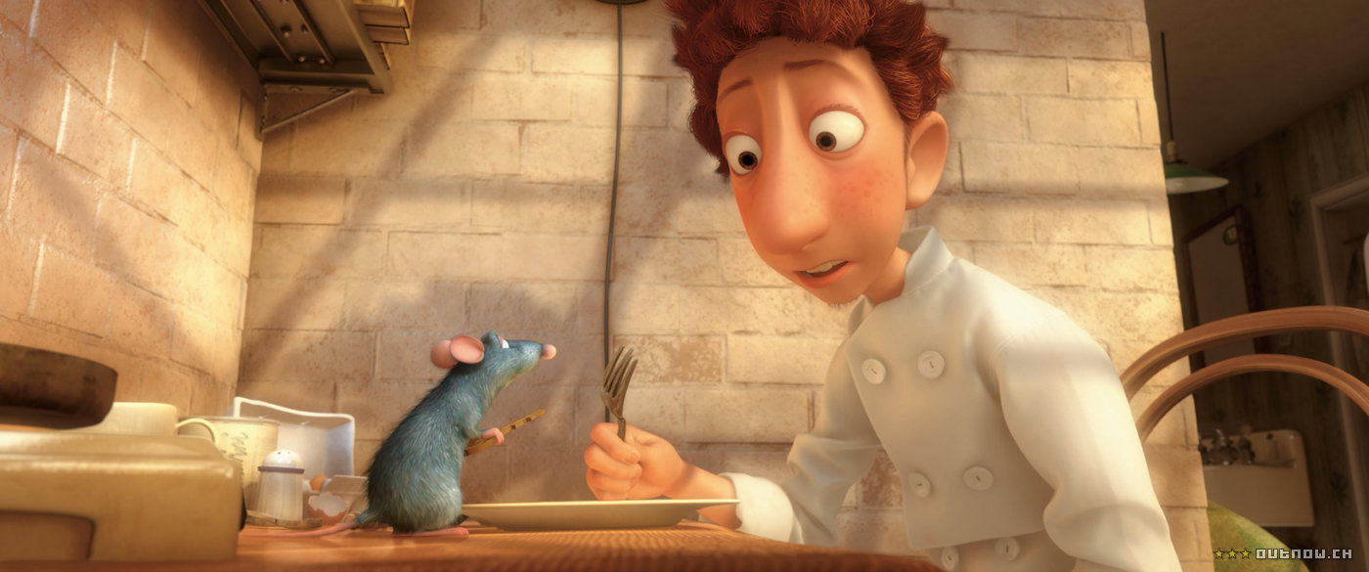
Lighting
High Key Lighting:
Very bright and associated with a light mood, cheer, or celebration.

Slide 21
Lighting
Low Key Lighting:
Very dark and full of shadows.
There is a strong contrast between light and dark areas of the shot.
Used in scenes that are frightening, suspenseful, or gloomy.

Slide 22
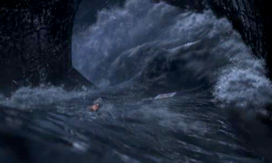
Low Key Lighting

Slide 23
Camera Movement
Panning:
The horizontal movement of the camera from side to side to follow the action in a scene.
Can be used as point of view shot in which the camera movement indicates a character scanning an area.

Slide 24
Camera Movement
Tilt:
The vertical movement of the camera.
The camera points up or down from a fixed base.
Can be used to establish setting by showing the height of something.
Ex. The camera can tilt up to show the height of the Empire State Building or tilt down to show the height of a cliff.

Slide 25
Camera Movement
Boom:
The camera moves vertically up or down through space.
The camera is not on a fixed point in space like the tilt movement.

