Slide 1










CURRENT EVENTS

Slide 2
What is news?
The one-question interview
Directions:
Write the interview question at the top of a blank sheet of paper.
Write your response to the question.
Ask the question to as many different students as you can in 10 minutes.
Record their name and briefly summarize and record their responses.
Discuss the similarities and differences in your response and your interviewees response.
At the end of 10 minutes, analyze the information and draw conclusions from the responses by answering the following:
1) Were there major differences between your prepared response and other’s responses?
2) Was there a response that made you reconsider your definition of the term “news” and Why?
3) What conclusions can you make from the varied responses to the question?

Slide 3
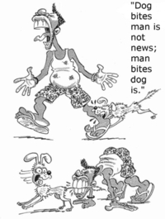
Famous Responses to “What is News?”
When a dog bites a man that is not news, but when a man bites a dog that is news.
Charles Anderson Dana, American journalist, 1819-1897
Well, news is anything that's interesting, that relates to what's happening in the world, what's happening in areas of the culture that would be of interest to your audience.
Kurt Loder, American journalist, b. 1945

Slide 4
Famous Responses to “What is News?”
What you see is news, what you know is background, what you feel is opinion.
Lester Markel, American journalist, 1894-1977
Put it before them briefly so they will read it, clearly so they will appreciate it, picturesquely so they will remember it and, above all, accurately so they will be guided by its light.
Joseph Pulitzer, American publisher, 1847-1911
News is anything that makes a reader say, `Gee Whiz'!
Arthur MacEwen, American editor
The real news is bad news.
Marshall Mcluhan, Canadian communications theorist, 1911-1980

Slide 5
What is News?
The definition of news has changed over time.
News was once only “hard news” or events.
  Government activity
  Political debates, elections
  Social issues
  Violent weather
  Speeches
  Auto or airplane accidents
  Press conferences
  Births, marriages, deaths

Slide 6
How is news currently defined?
News still means “hard news,” but it also includes:
trends, like ways to “go green” (to be environmentally friendly) or new uses of technology;
lifestyle choices, like ways to add exercise to a person’s daily routine or to eliminate stress;
fashion, like the effects of high heels on feet;
sports, like the enforcement of a zero-tolerance policy on slashes.

Slide 7
How and why has news changed?
News providers face the following dilemma:
Give readers what they need and readers may find the information “boring.”
OR
Give readers what they want and the information will be “superficial.”
Can you think of examples where information could be boring, but necessary for the reader?
Can you think of examples where information could be superficial?

Slide 8
What caused this change in news?
Newspapers changed what they covered as “news” because of several factors:
  a change in the direction of society;
  declining literacy;
  a loss of young readers;
  a drop in circulation;
  a more mobile society;
  television’s influence (upbeat, spectacular, sensational);
  and readers were tired of “bad news.”

Slide 9
What caused this change in news?
Newspapers changed the way they presented “news” because of several factors:
  USA Today introduced a printed paper that was colorful, upbeat, included many graphics, more photos, more sidebars, less depth in story structure, and was not concerned with city hall;
  the Internet provided audiences with global access and created skeptical consumers;
  and society developed a different view
  from the previous idea that the press
  must provide society mainly with “hard
  news” that has an emphasis on government.

Slide 10
How do we access news?
Activity: Where does my news come from?
Types of News | Sources and Topics
 | TV | Radio | Newspaper/ Magazines | Internet
Local News | -global OK/Van | SUN FM Q Juice Power | Daily Courier Okanagan Life Capital News Kelowna Now | Kelowna Now Castanet Global
National News | CTV cbc TSN | CBC Radio | Toronto Sun | Google News CBC
World News | CNN ESPN | CBC Sirius XM | -New York Times Wall Street Journal | Google News Youtube CNN
School News | KNOX News | Announcement | Home Letter | Freshgrade Google Classroom
News about famous people | -ET TMZ MTV E | Local Station Ryan Seacrest | People Time Sports Illustrated | Social Media TMZ
News about family/friends |  |  |  | Social Media

Slide 11







Local News
Resources

Slide 12










Global News
Resources

Slide 13
Fake News
What are potential consequences when fake news goes viral? Do you think you could spot fake news or would you be fooled? Why or why not?

Slide 14
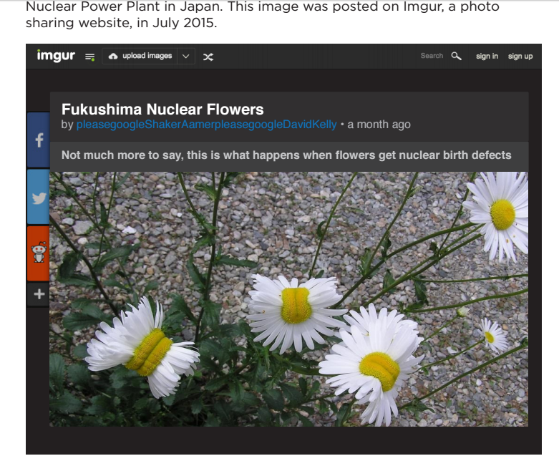
Challenge
Is this credible?
Why or Why Not?
Questions to consider:
Who is the author of this article and where is it published?
Where is the photo taken? How far away from the nuclear disaster?
Are flower mutations only the result of radiation exposure?

Slide 15
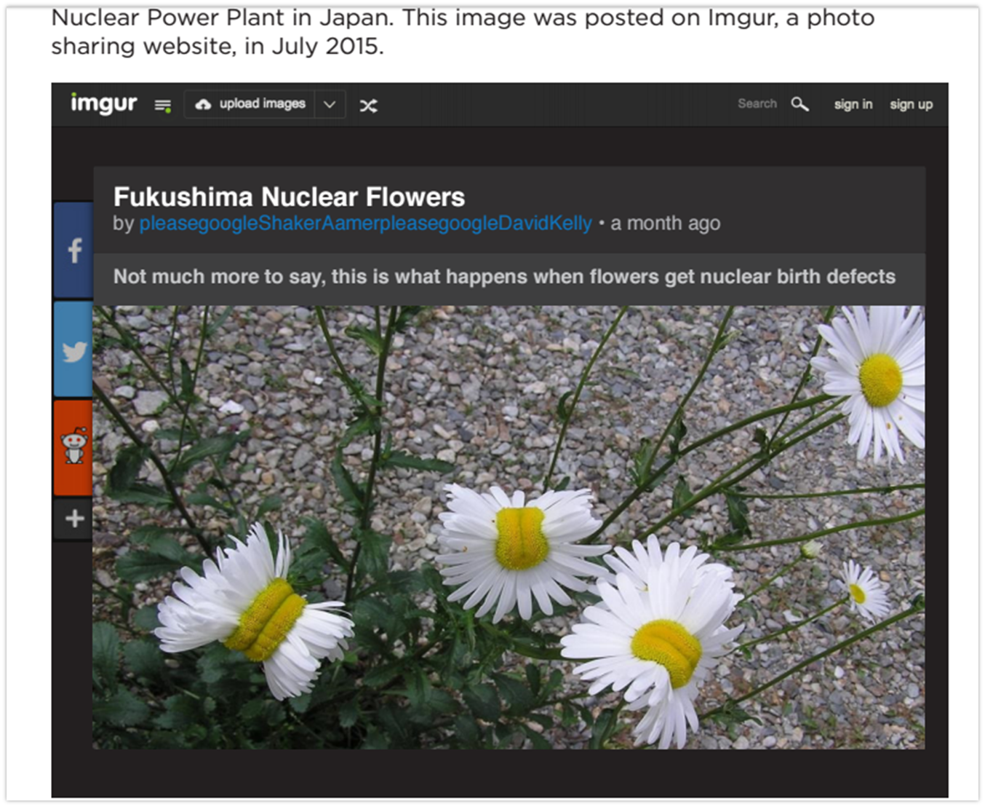
FACTS
The picture was taken in Nasushiobara City.
That’s about 108 miles (173 kilometers) southwest of the Fukushima Daiichi power plant.
Apparently these types of mutations have been recorded in many places globally, often not near any types of radiation.

Slide 16
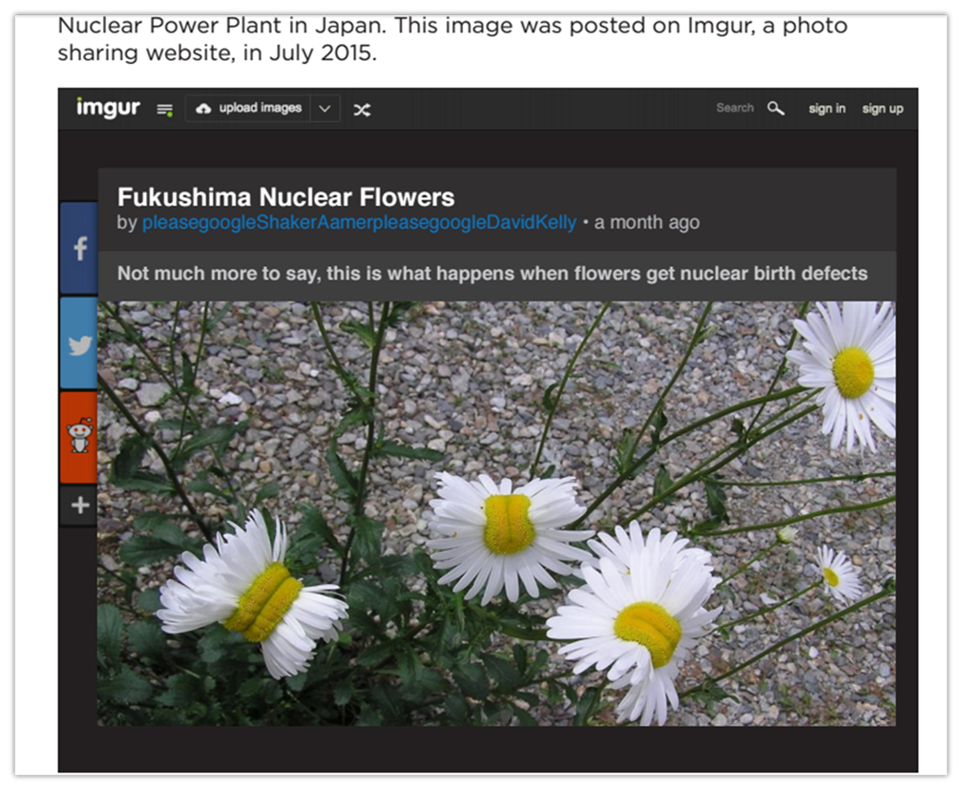
Results
The photo gives the impression of credibility, but the cause/effect relationship is not scientifically proven.
Nonetheless, 20% of students thought the picture in particular proved that radiation from Fukushima was causing big problems.

Slide 17
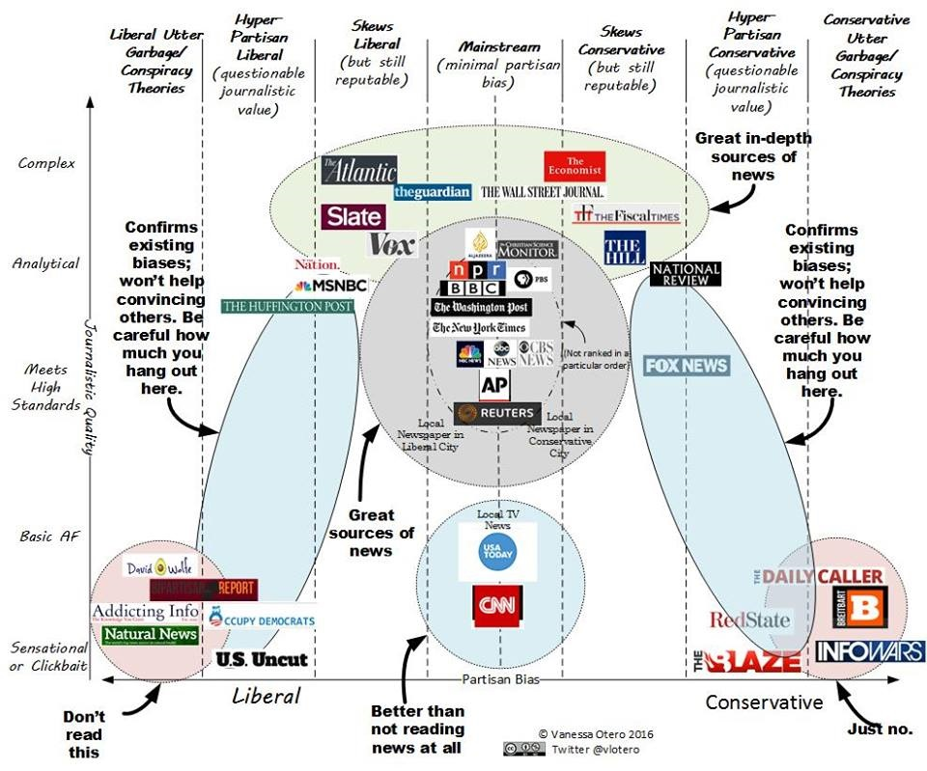
This chart shows the extent to which people trust various media sources, from most trusted at the top, to least trusted at the bottom.

Slide 18
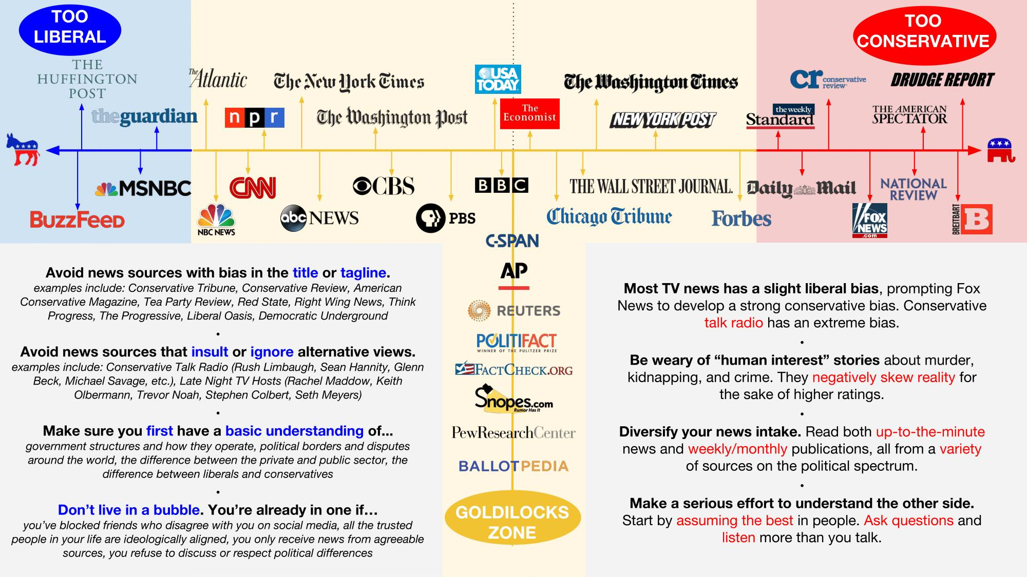

Slide 19
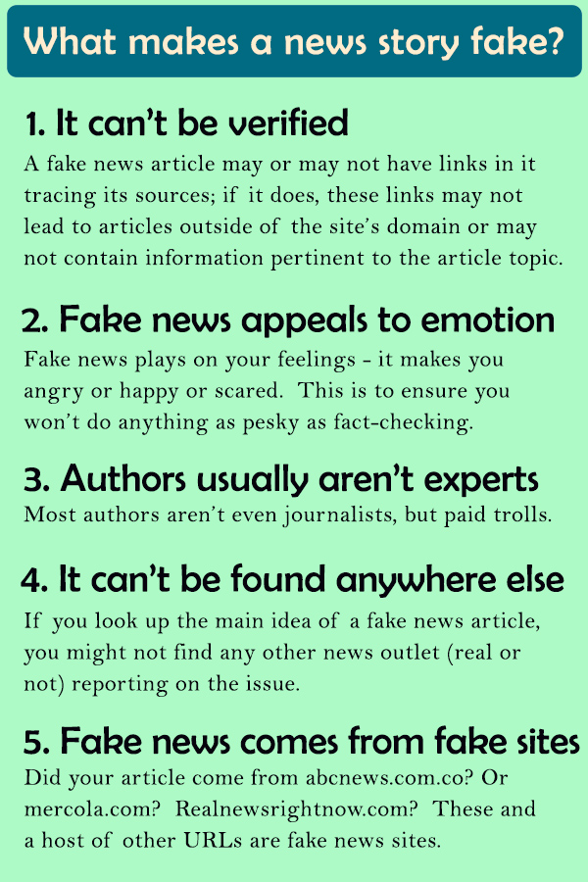
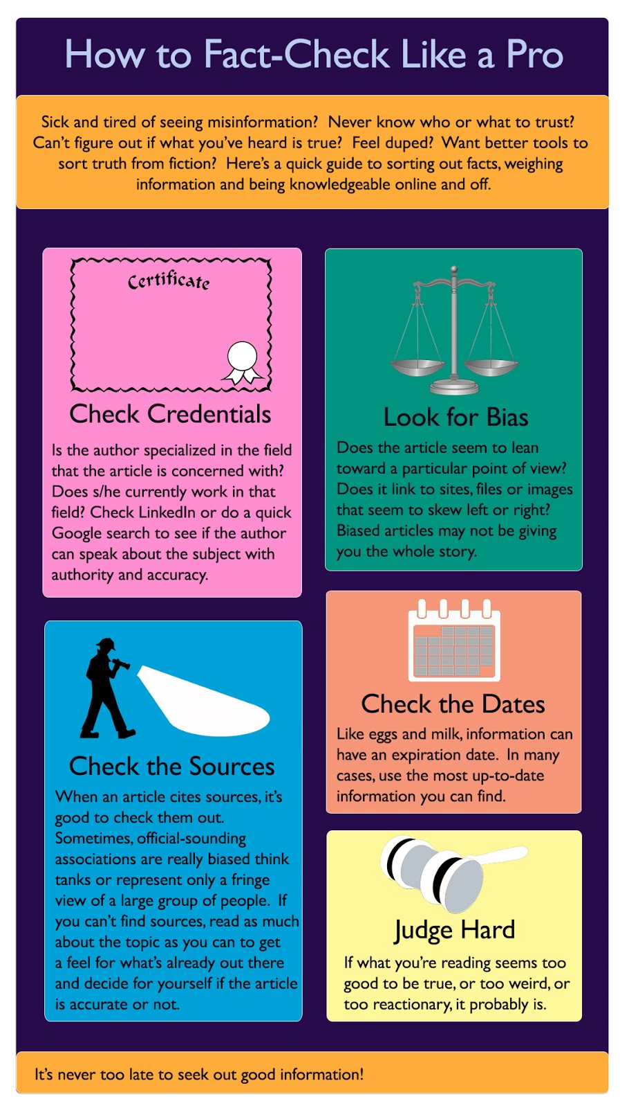
Fact Check
The first thing to do is move off the questionable site. If the site is trying to deceive you, getting information from them is counterproductive.
Instead, google the site, the author, the data, using neutral terms to try to get to the truth.

Slide 20

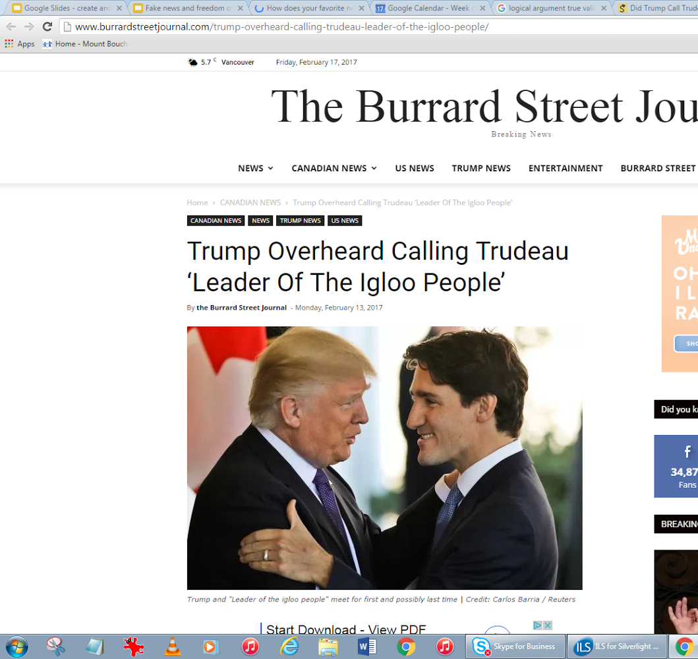
Fact Check
Practice
http://www.burrardstreetjournal.com/trump-overheard-calling-trudeau-leader-of-the-igloo-people/
When researching the validity of the story:
No one else is reporting the story.
Google: Snopes article says its satire (fake)
The Burrard Street Journal is a known fake news site. Logo is BS Journal (get it?)

Slide 21
Fake News Tips
One step individuals can take is to vet their sources, choosing those that are more reliable. Of course, just because people generally believe the sources are reliable doesn’t mean they actually are. How can a person vet a source to make sure it is indeed reliable? Perhaps checking a few sites can help.
Note that one of the more trusted sources on the list is ABC news. There is a fake news site at the url abc.com.co that looks very official and can be easily confused with the real ABC news.
Also, sometimes when we double check we are confirming our bias. If we search, for example, “fukushima double daisies truth”, are we going to get useful hits?

Slide 22
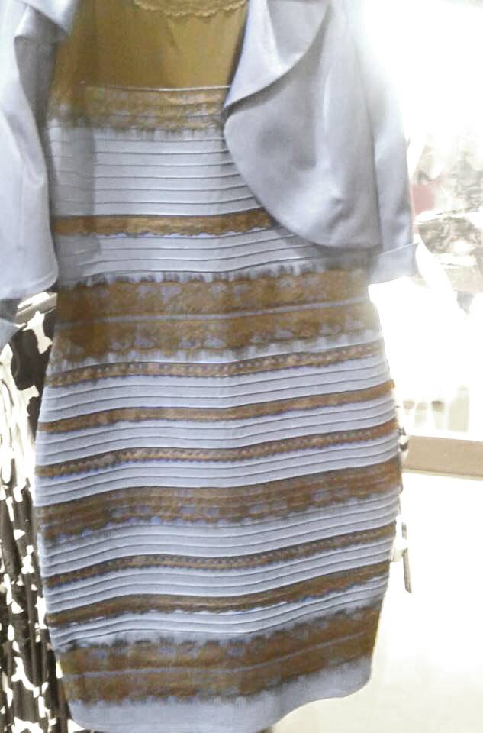
Fake News Tips
Note that the chart is divided by political orientation. If you search sites with a similar orientation, are you getting a broad perspective? This is a filter bubble. Your google search hits will be sorted by your favorite sites first if you don’t clear your history and cookies, giving you the same perspective.
If you believe a particular story because all your social media sources are declaring it true, it might be because you’re in an echo chamber. You are giving each other the same information, just echoing it back and forth to each other.
Finally, as sources become viral, they amplify the importance given to the information, when really it might be a minor story.

Slide 23
General Strategies to Avoid Fake News
•Verify with fact checking sites like Snopes
•Check for sponsorship
•Search images in omnibar
•Search website reputation - against lists of fake news sites
•Search data using neutral terms (be wary of confirmation bias and filter bubble)
•Search author’s credentials
•Be aware of problems using social media sites as resources (echo chamber and amplification)
•Cross check data against reputable sources
•Assess logic of arguments
•Check if site is satirical
•Be wary of emotionally provocative

Slide 24
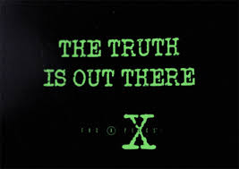

Slide 25
Analyzing News
Good readers use text features to figure out what a passage is about before they even begin reading it.
This strategy is called previewing.
Previewing a text helps readers better understand it once they start reading.
Previewing helps readers get a sense of what the text is about so they can focus on important information while they are reading.

Slide 26
Analyzing News
Text Feature | How it helps
Title | Gives readers an idea of what the article will be about Can make predictions about the topic
Headings | Introduce the topics within the article Make questions from headings to help with understanding the main ideas of each section
Illustrations | Tell something about the article Help understand key ideas, often by simplifying ideas from the text
Photographs | Show real objects or subjects in a real setting
Caption | Explains what’s in the picture Usually summarizes 5 W’s and H
Sidebar | Contains an interesting fact (or set of facts) related to something in the article
Bold or italic print | Signals important information or new words
Glossary | Defines new words
Diagram, chart, graph, table or map | Gives information in a visual way so it is quicker and easier to understand

Slide 27
Julie Payette
Preview Julie Payette article as a class.
Record an example of what you learned from each text feature on a sheet of paper.
Text Feature/ Observation | What I learned from previewing the article
Title: A New Mission for Julie Payette | I think this article will be about Julie Payette.
Illustration: A woman in a space suit. She has a Canadian flag patch on arm. | Julie Payette is most likely a Canadian astronaut.

Slide 28

The 5 W’s & H Strategy
WHO
WHAT
WHEN
WHERE
WHY

Slide 29

The 5 W’s & H Strategy
HOW

Slide 30

WHO needs to know about this current event?
Who is the intended audience

Slide 31
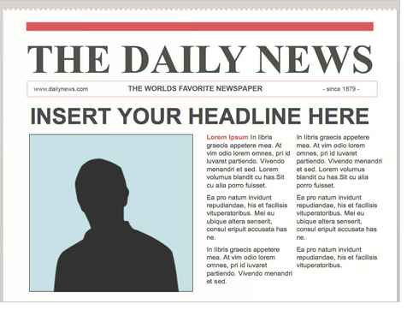
WHAT is this current event about?
Main ideas
Important supporting details
Important background knowledge needed to understand event

Slide 32
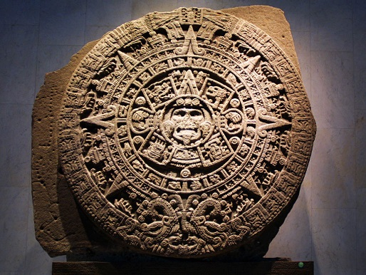
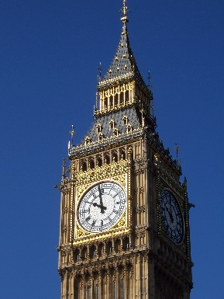
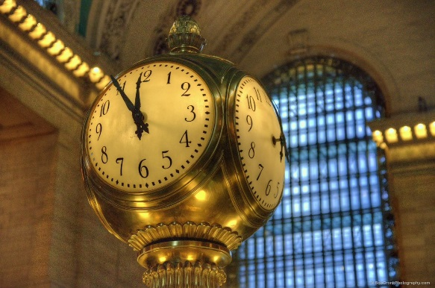
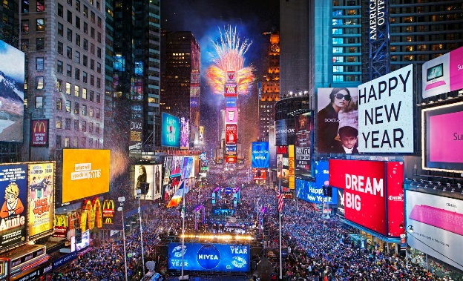
WHEN did this event happen?

Slide 33
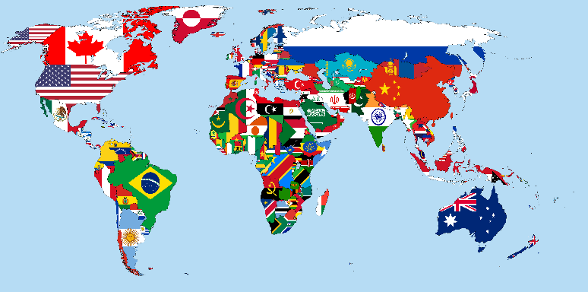
WHERE did this event occur?
(Location – Be specific)

Slide 34

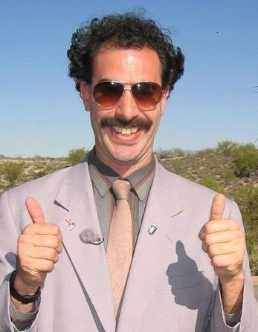
WHY is this event important and newsworthy?

Slide 35



HOW do you feel about this event?
HOW do other interested parties feel about this event?

Slide 36
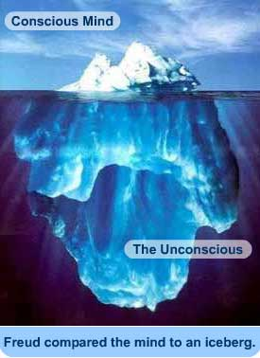
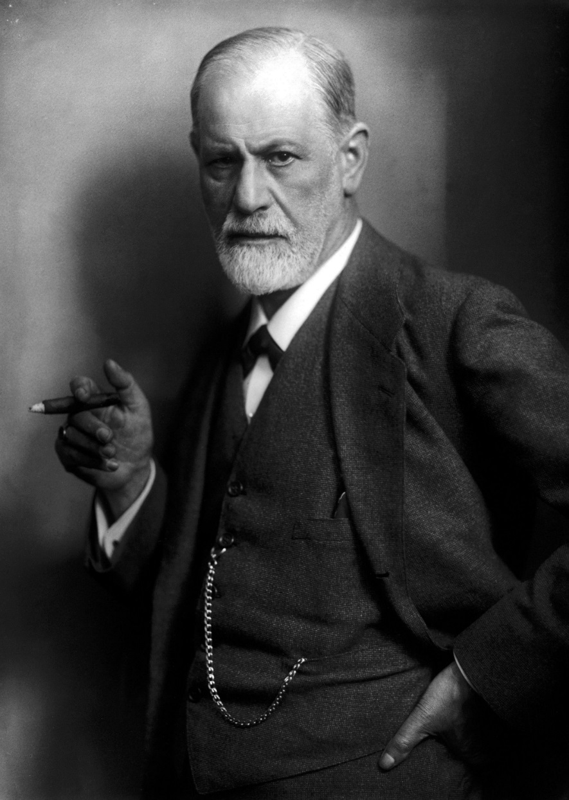
HOW
“Words have a magical power. They can bring either the greatest happiness or deepest despair; they can transfer knowledge from teacher to student; words enable the orator to sway his audience and dictate its decisions. Words are capable of arousing the strongest emotions and prompting all men’s actions.”
http://www.biography.com/people/sigmund-freud-9302400

